Slide 1
Project organisation
Complex Human Data Summer School
Notes:
mainstream

Slide 2
Why workflow matters
A good workflow
saves time in the long run
helps you avoid errors
makes it easy for others to reproduce your work
Folder organization is critical for all of these things

Slide 3
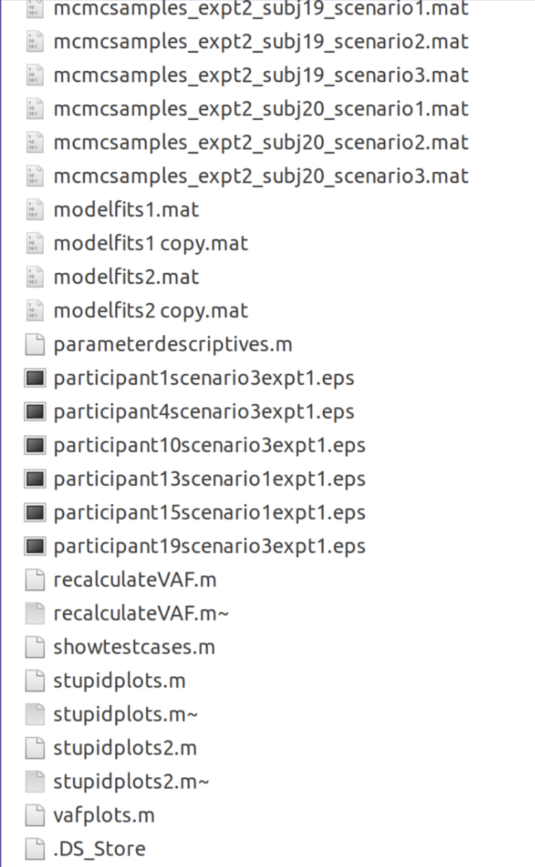
One of Danielle Navarro’s folders from 2009

Slide 4
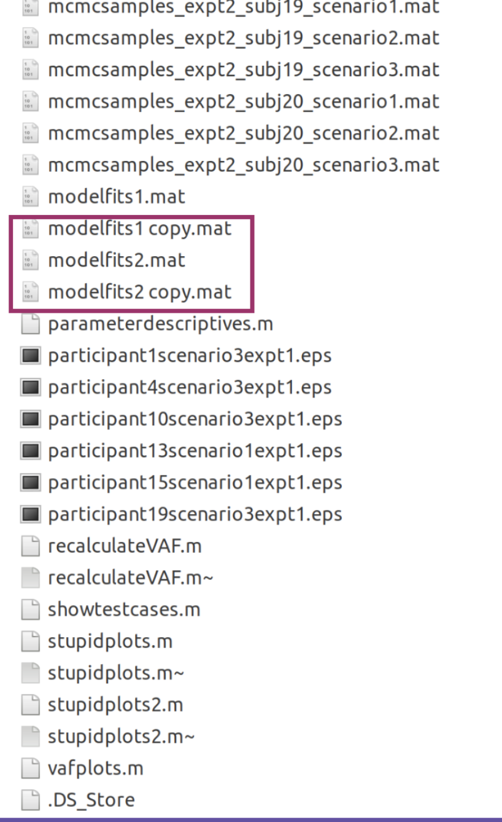
Multiple copies of files

Slide 5
White space in filenames is a bad idea

Slide 6
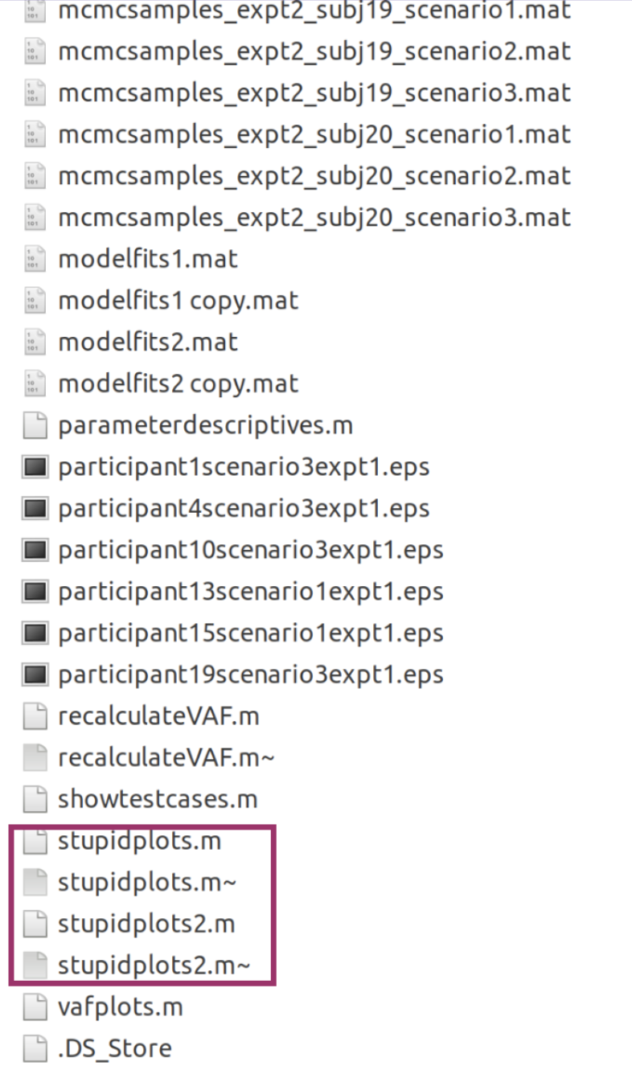
Slightly embarrassing filenames

Slide 7
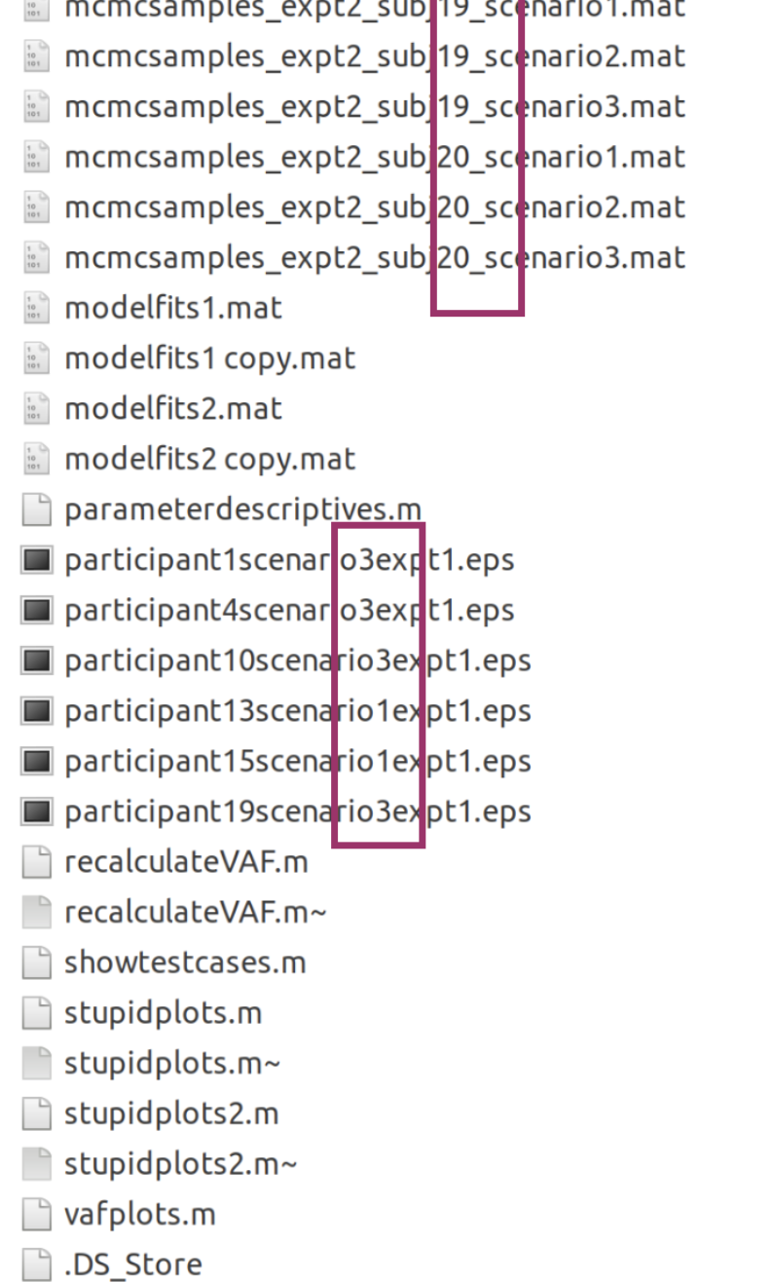
Inconsistent separator characters

Slide 8
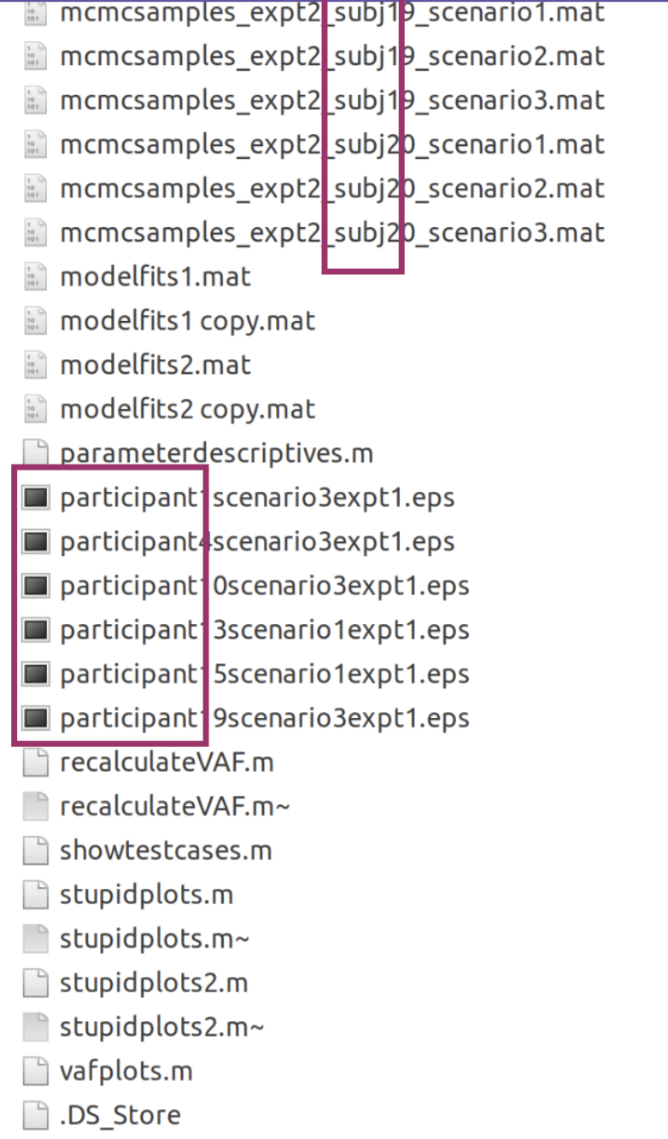
Inconsistent naming scheme

Slide 9
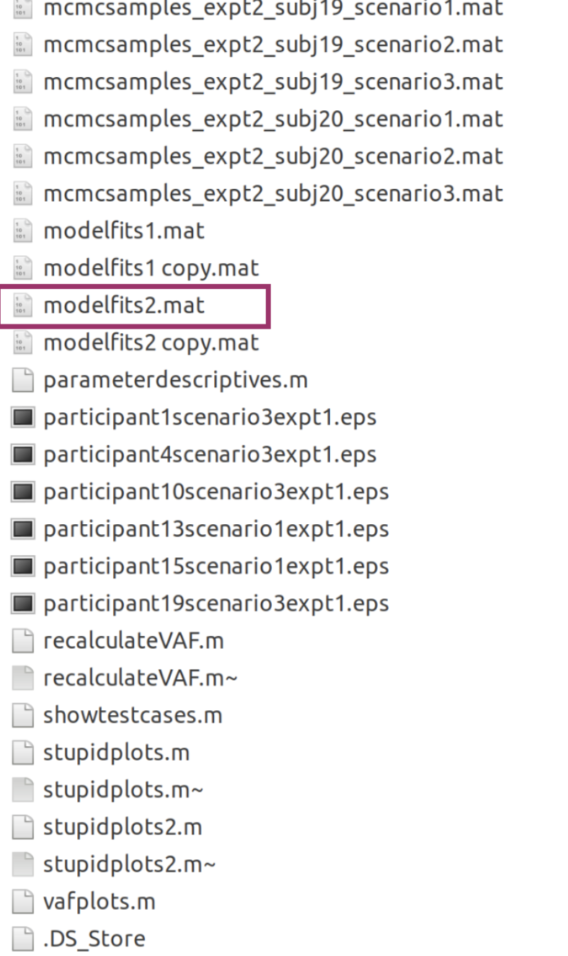
Filenames that aren’t very helpful

Slide 10
Not just Dani!

Slide 11
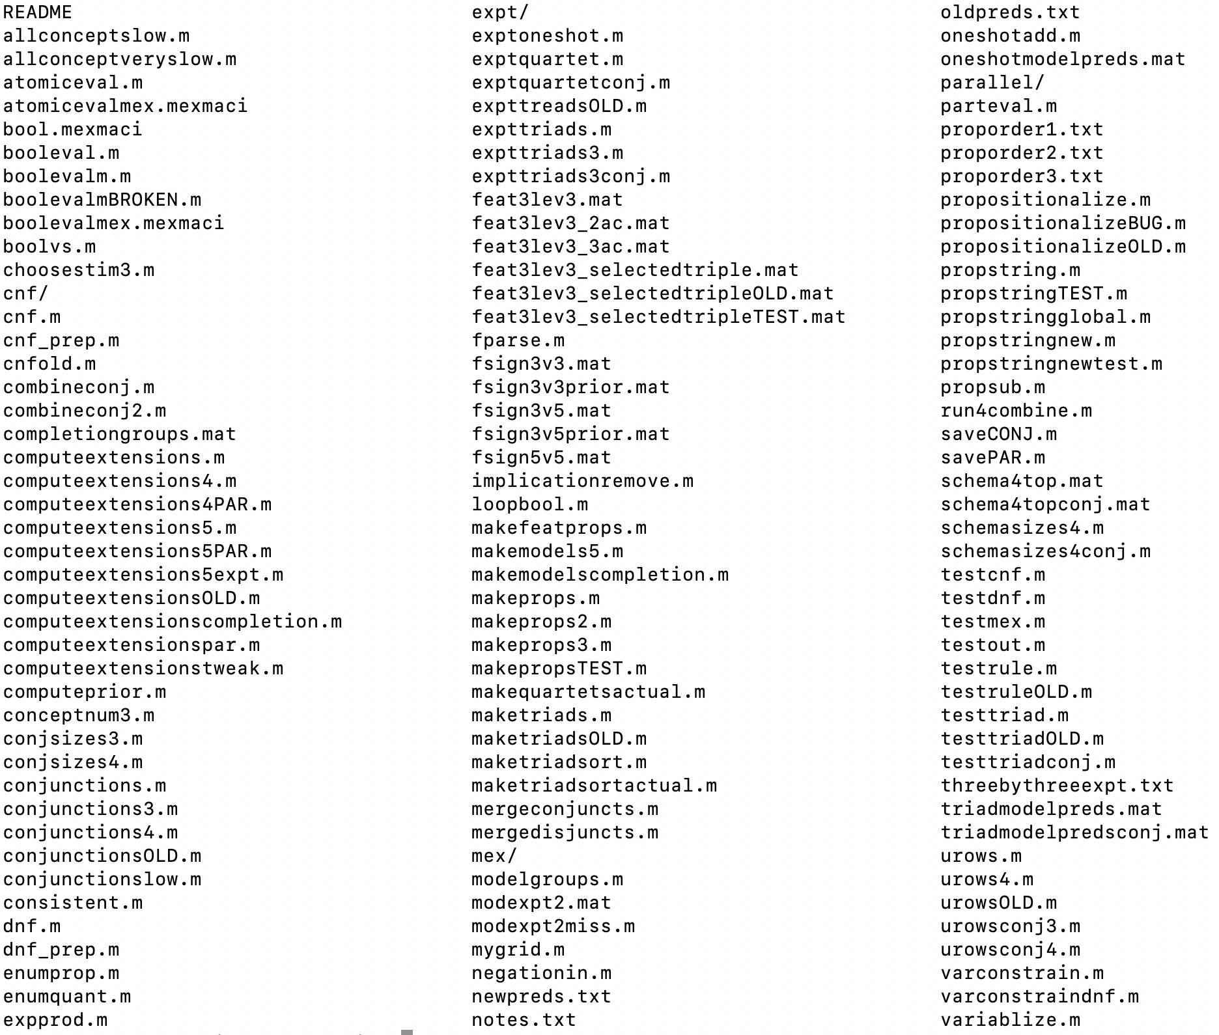
One of my folders from 2010

Slide 12
File organization and naming are powerful weapons against chaos
Jenny Bryan

Slide 13
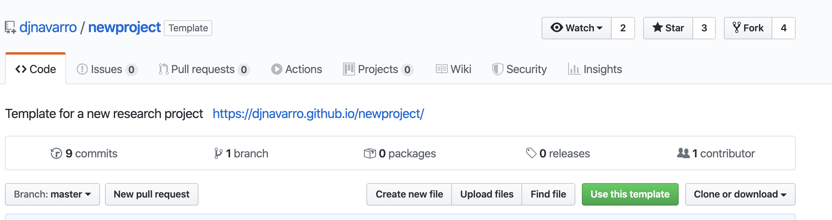
newproject template
Exercise:
Use this template to create a new repository called pitchmemory
Clone the repository inside your CHDS folder

Slide 14
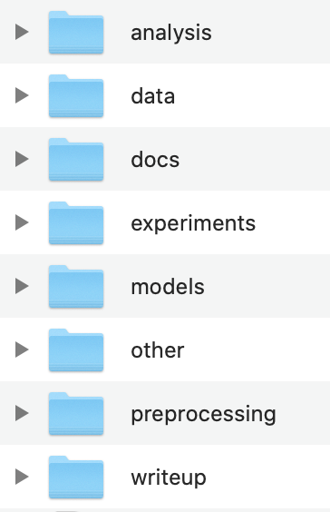
Folder structure
Contains a subfolder for each experiment

Slide 15
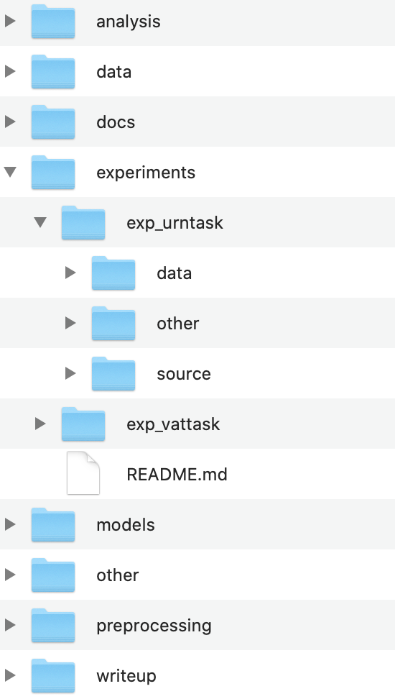
Folder structure
Each experiment folder has subfolders for data and source code

Slide 16
Folder structure
Scripts for cleaning the data

Slide 17
Folder structure
Cleaned data files

Slide 18
Folder structure
Scripts for exploratory analyses and statistical tests

Slide 19
Folder structure
Models (if this is a modelling project)

Slide 20
Folder structure
Manuscripts, talks, posters

Slide 21
Folder structure
Used if you want to turn your project into a GitHub pages website

Slide 22
Folder structure
A README in every folder

Slide 23
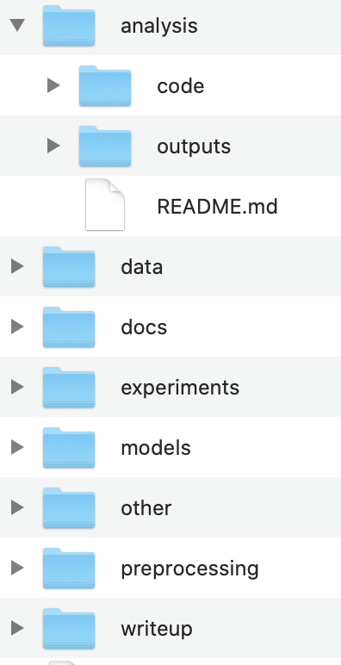
Other ideas
Separate outputs (e.g. figures) from the code that generated them

Slide 24
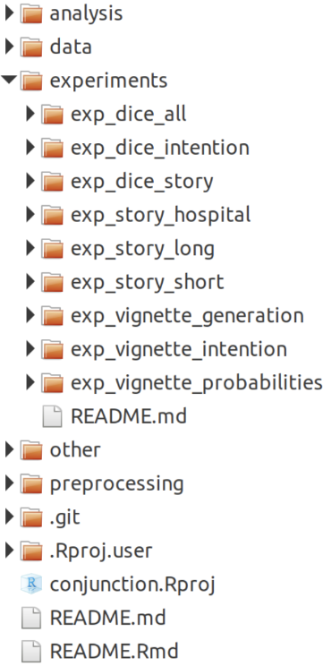
Filenames
Files and folders should use a consistent naming scheme that is easy for both humans and machines to read

Slide 25
RStudio projects
Projects let you separate and easily switch between different things that you might be working on.
[DEMO]
Exercise: create a project for your summerschool repository

Slide 26
Benefits of Projects
If you open a project by clicking on the .Rproj file, you’ll automatically be in the right directory
You can easily switch between projects using the menu in RStudio.
Projects help you specify paths using the here package

Slide 27
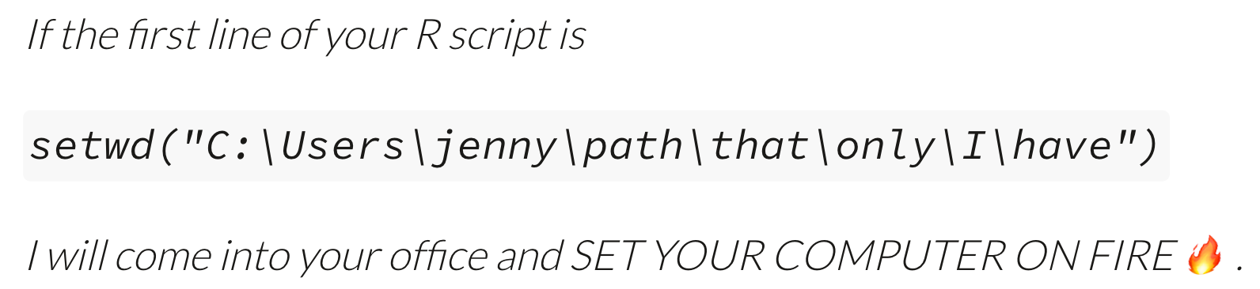
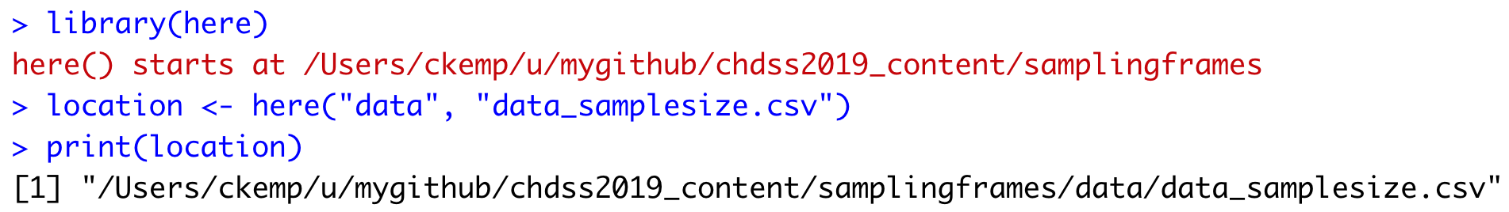
Jenny Bryan
A better approach

Slide 28
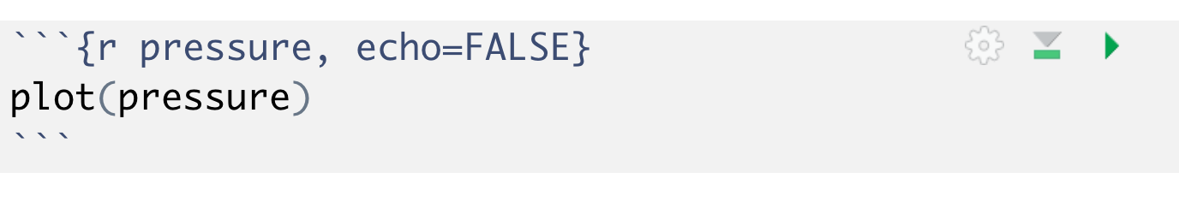
R Markdown
R Markdown lets you make documents that combine text and code.
Demo/Exercise:
Switch to your summerschool project and create a new R Markdown document
Knit the document to create an .html file
Figure out the buttons at the top-right of a chunk
Set eval=FALSE at the top of a chunk and see how that changes the .html produced by Knit

Slide 29
What’s R Markdown useful for?
Preprocessing and analyzing data
Making runnable research notebooks
Making slides
Writing journal papers (using papaja)
…

